Slide 1
Data Visualization Techniques & Best Practices

Slide 2
What Is Data Visualization
Data visualization means representing data in a visual form (like charts, graphs, maps, or infographics) so that complex information becomes easy to understand and interpret.
Examples: Charts, maps, dashboards, infographics

Slide 3
Why Data Visualization Is Important
Data visualization is an essential skill for data analysts, business professionals, and researchers because:
Simplifies complexity: Converts large datasets into simple visuals.
Identifies insights: Shows trends, relationships, and hidden patterns.
Aids decision-making: Helps management make evidence-based decisions.
Improves storytelling: Turns numbers into stories that anyone can understand.
Example: A line chart showing rising temperature trends is easier to explain than pages of numeric temperature readings.

Slide 4
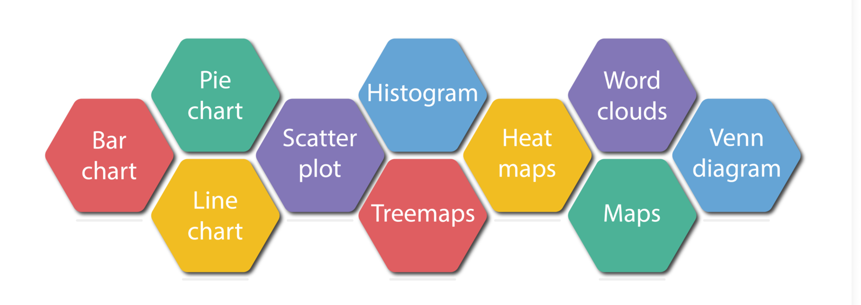
Common Data Visualization Techniques

Slide 5
Types of Data Visualization
Technique | Description | Example Use
Bar Chart | Compares categories | Sales by product
Line Chart | Shows trends over time | Monthly revenue growth
Pie Chart | Displays proportions or parts of a whole | Market share
Scatter Plot | Shows relationships between variables | Age vs. Income
Histogram | Shows frequency distribution | Exam score distribution
Heatmap | Shows intensity of data values | Website click activity
Map Visualization | Displays geographic data | Sales by region

Slide 6
Data Visualization Tools
Basic Tools: Microsoft Excel, Google Sheets
Professional Tools: Tableau, Power BI
Programming Libraries:
  Python: Matplotlib, Seaborn, Plotly
  R: ggplot2

Slide 7
Key Design Principles for Effective Visualization
Clarity: Remove unnecessary decorations, focus on the main message.
Simplicity: Keep it clean — too many colors or fonts can confuse viewers.
Accuracy: Avoid misleading scales or 3D effects that distort the data.
Consistency: Use uniform colors, fonts, and styles across visuals.
Focus: Highlight key insights (for example, use color to emphasize one important bar).

Slide 8
Choosing the Right Type of Chart
Goal | Recommended Chart Type
Compare categories | Bar or Column Chart
Show trend over time | Line Chart
Show part-to-whole | Pie or Donut Chart
Show correlation | Scatter Plot
Show data distribution | Histogram or Box Plot
Show geographical pattern | Map Chart

Slide 9
Common Mistakes to Avoid
Using too many colors or text — distracts from the main insight.
Misleading scales — e.g., starting a Y-axis at 50 instead of 0 exaggerates differences.
3D Charts — look fancy but distort values
Too much information — showing too many variables at once confuses the audience.
Ignoring context — a chart without a title, axis labels, or units is meaningless.
Always keep your visualization simple, clear, and honest.

Slide 10
Best Practices for Great Visualizations
Keep it simple
Use color meaningfully
Highlight key insights
Use labels & legends wisely
Always test with your audience

Slide 11
Advanced Visualization Techniques
Interactive Dashboards: Let users click and explore data (Power BI, Tableau).
Real-time Data Visualization: For monitoring live metrics like stock prices.
Storytelling with Data: Combine visuals with narrative to explain insights.
AI-powered Visualization: Automatically generates charts and detects trends.

Slide 12
Summary
Data visualization turns data into insight.
Use the right chart type for your goal.
Follow design best practices for clarity and accuracy.
Avoid common mistakes like clutter, wrong scales, and poor labeling.
Good visuals tell a story and make data easy to act on.

Slide 13
Thank You

